Slide 1
Auguroid
Marco Salazar

Slide 2
Predicting Downloads
Can future installs be predicted?
Using Google Play Data
Linear Model vs Logistic Classifier vs DNN
SoftMax vs Pure Numbers

Slide 3
Google Play Dataset

Slide 4
A Messy Dataset
Application Name - String
Category - String
Rating - Number
Number of Reviews - Number
Disk size of the app - String
Number of Installs - String
Type (Paid or Free) - String
Price - String
Content Rating - String
Genres - String
Last Update - String
Current Version - String
Android Version - String

Slide 5
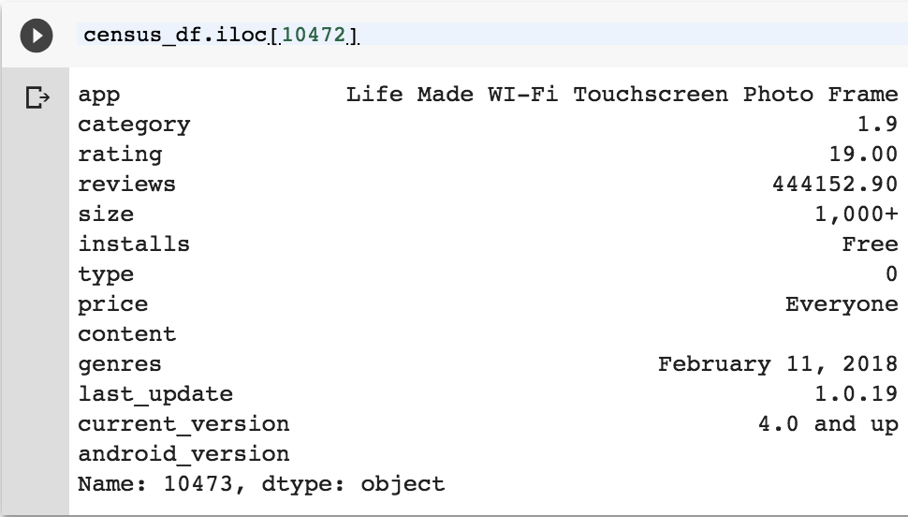
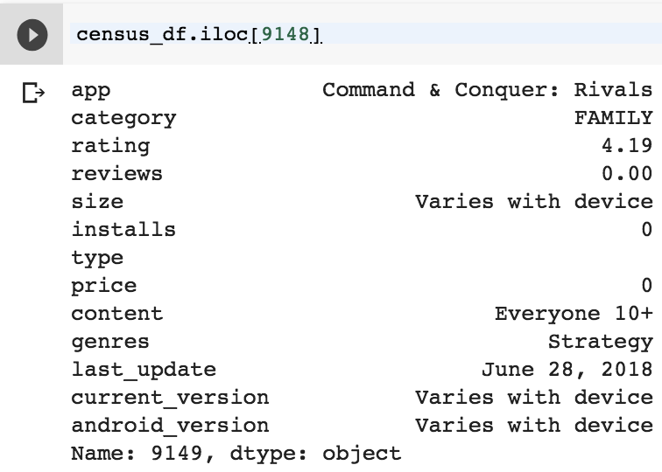
Reformatting
Useless: Application Name, current version, genres, and last update
Size had ‘M’ and ‘k’, Price had ‘$’
Dataset was not Clean!!

Slide 6
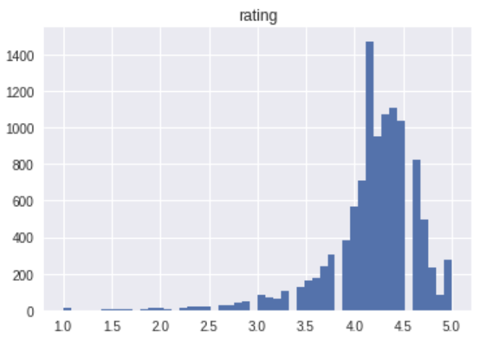
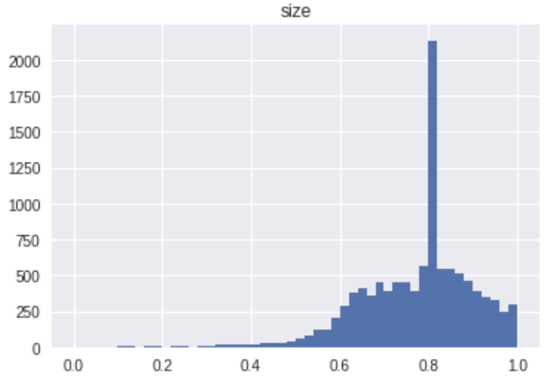
Average of 4.2
More positive than expected
Tall point is just the median
Needed log scale to resize

Slide 7
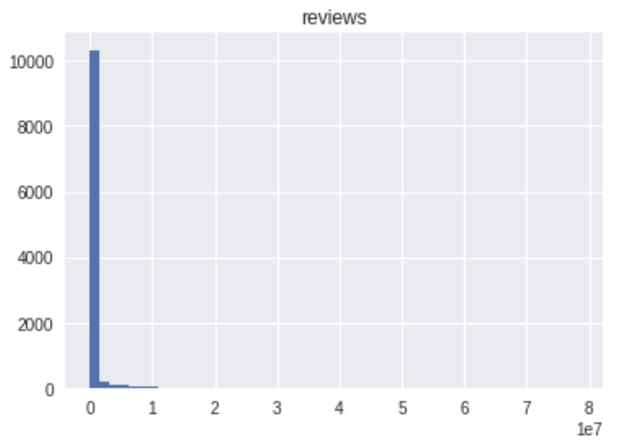
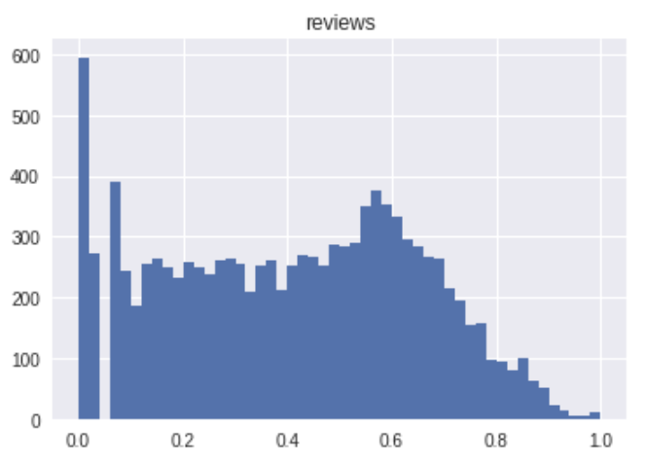
Very uneven scale that mostly needed log scaling

Slide 8
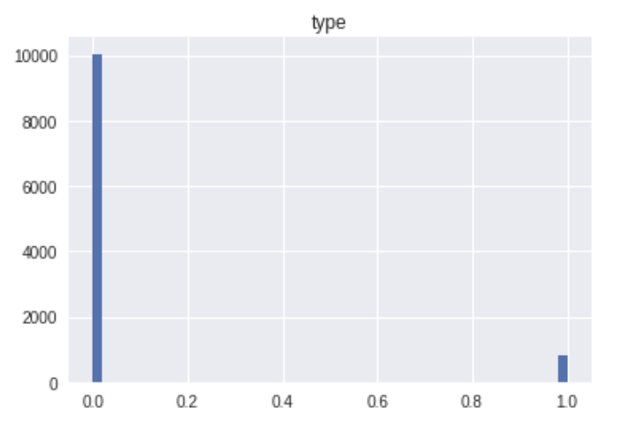
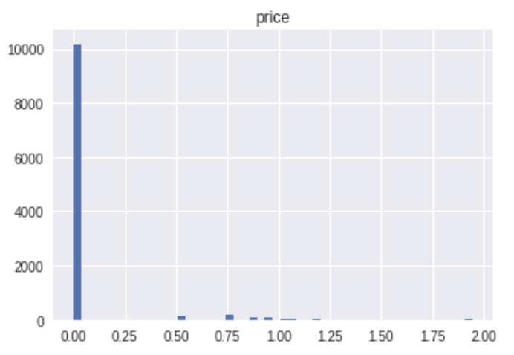
10:1 Free apps to Paid
Of the paid, ranged up to 80$
A few Joke apps set in the 250$

Slide 9
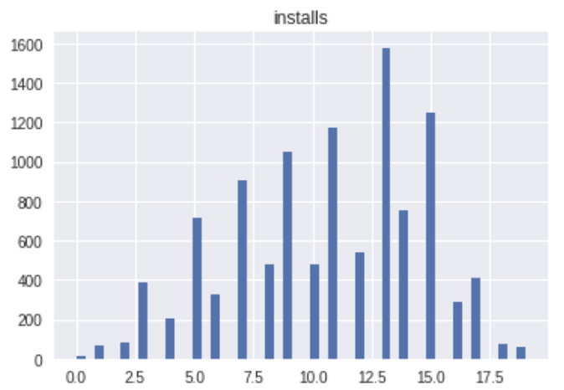
0+ 0
1+ 1
5+ 2
10+ 3
50+ 4
100+ 5
500+ 6
1,000+ 7
5,000+ 8
10,000+ 9
50,000+ 10
100,000+ 11
500,000+ 12
1,000,000+ 13
5,000,000+ 14
10,000,000+ 15
50,000,000+ 16
100,000,000+ 17
500,000,000+ 18
1,000,000,000+ 19

Slide 10
The Linear Model

Slide 11
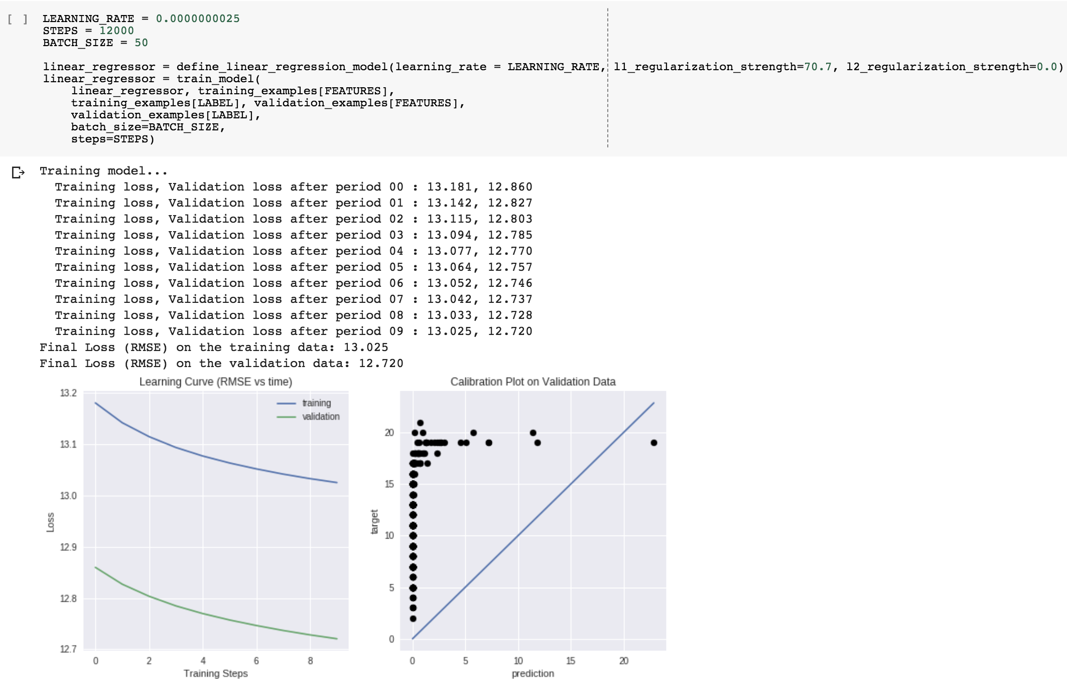
Earliest Model

Slide 12
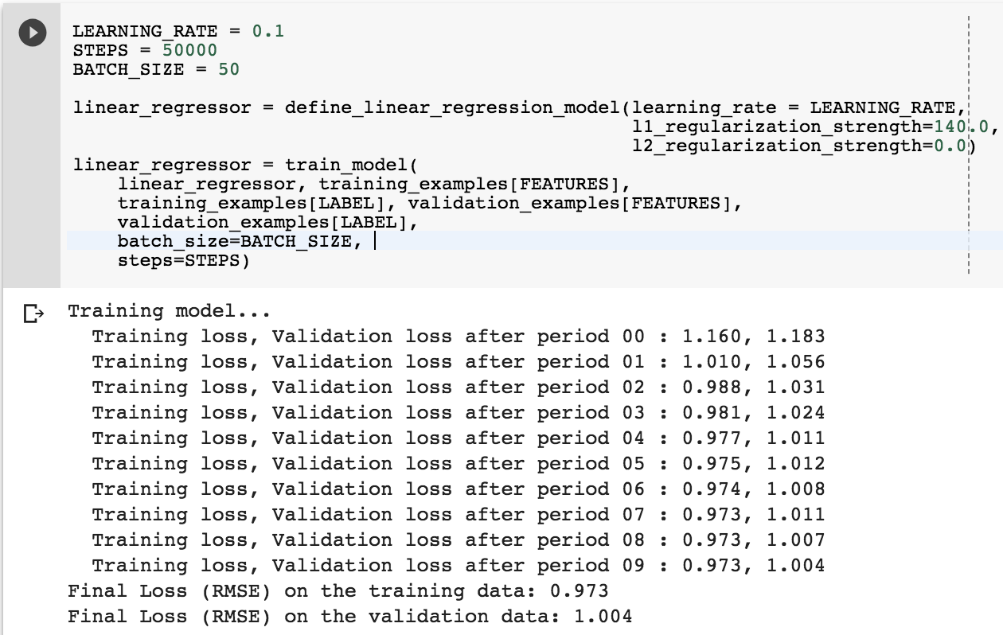
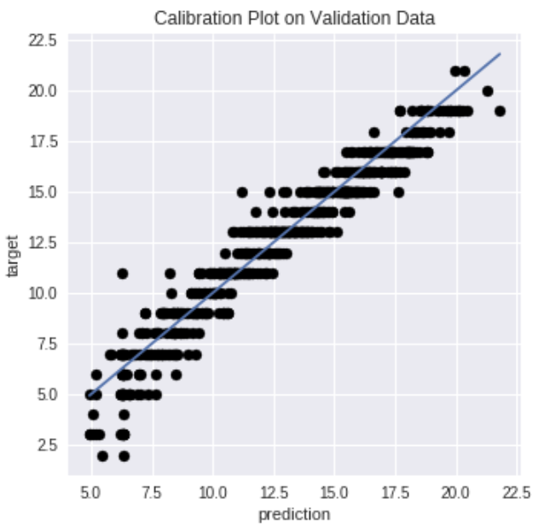
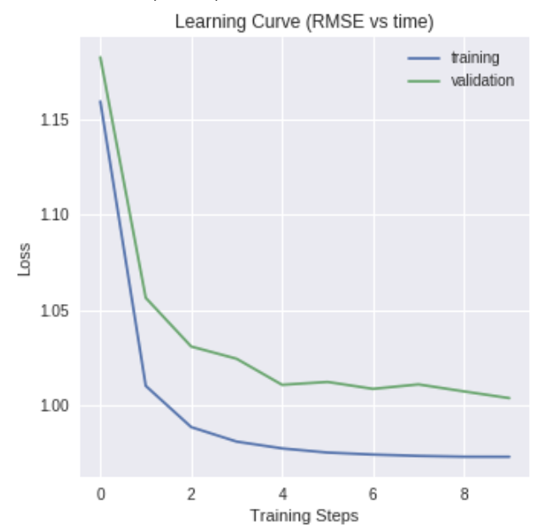
Overfitting

Slide 13
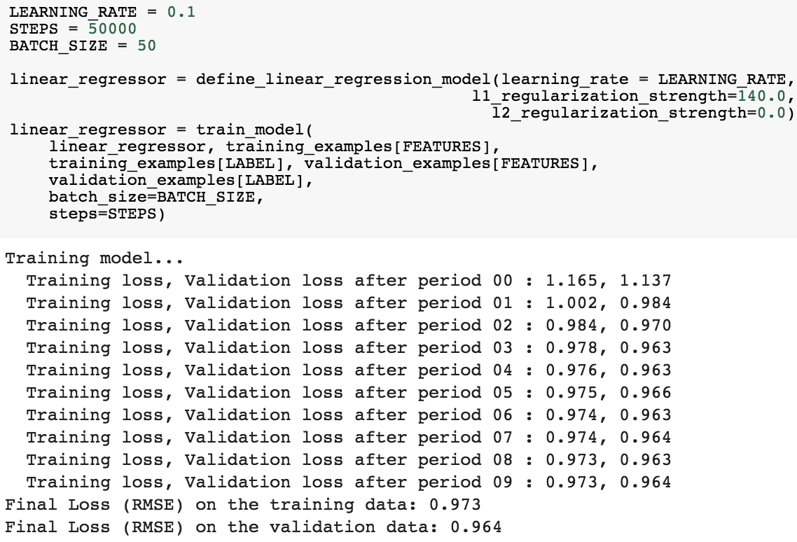
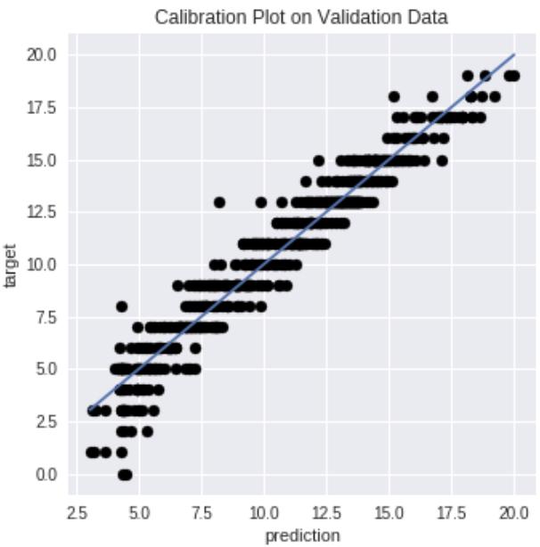
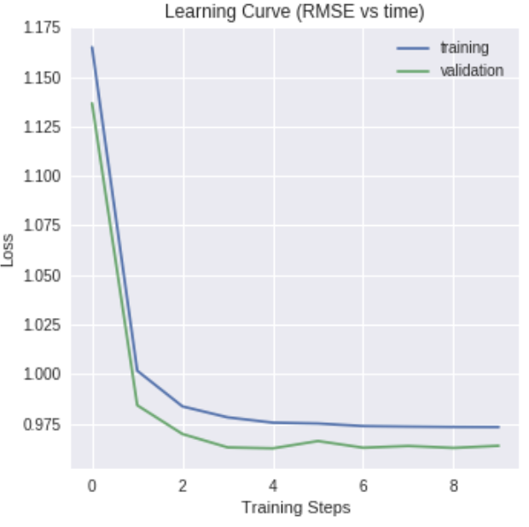
Best Model

Slide 14
Logistic Regression

Slide 15
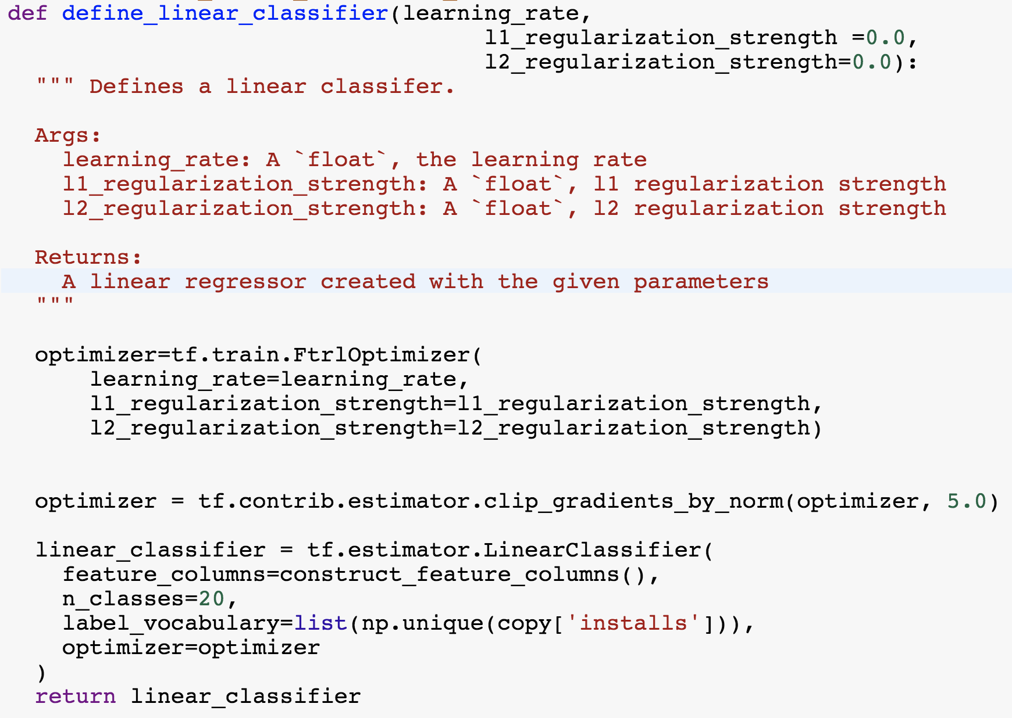
Setting Up SoftMax
Softmax for 20 classes
label_vocabulary needs list
of classes
Infrequent members produce
errors
Reduce classes
Increase validation data size

Slide 16
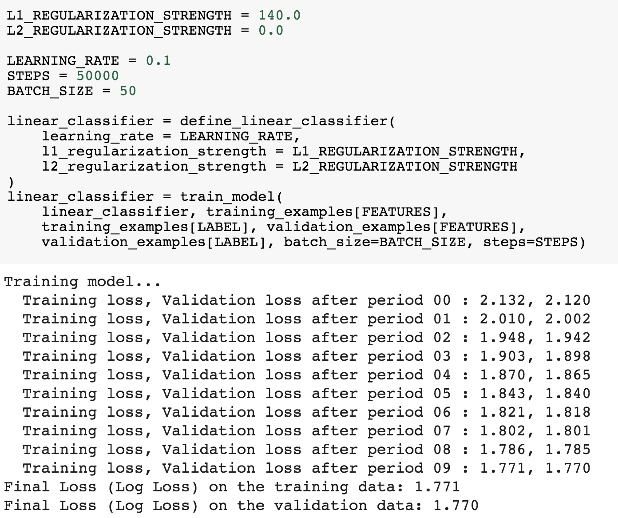
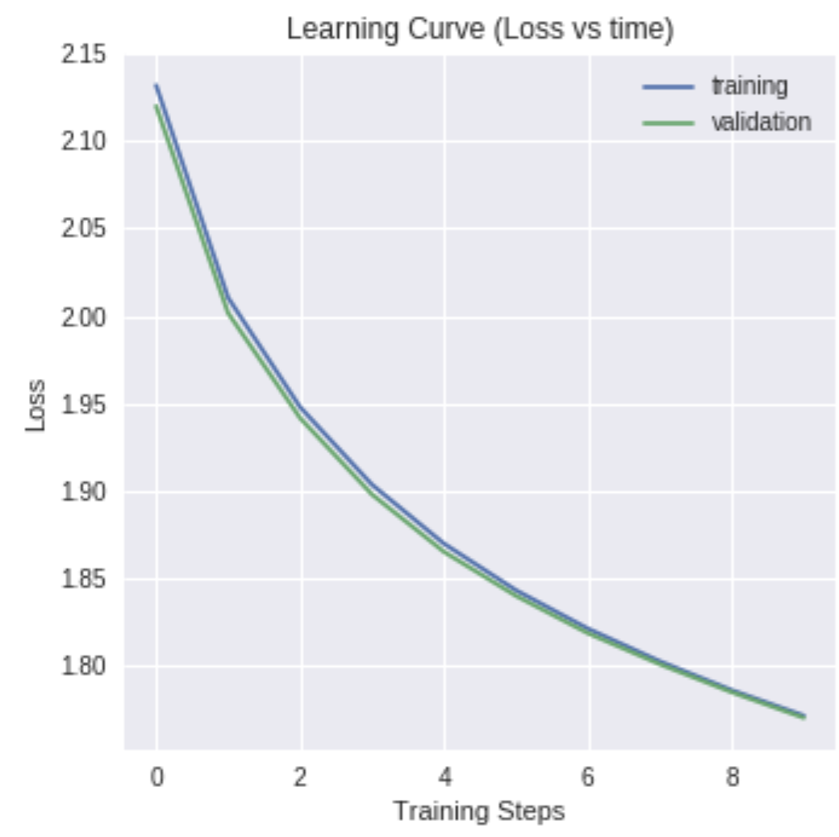
Without Modifications

Slide 17
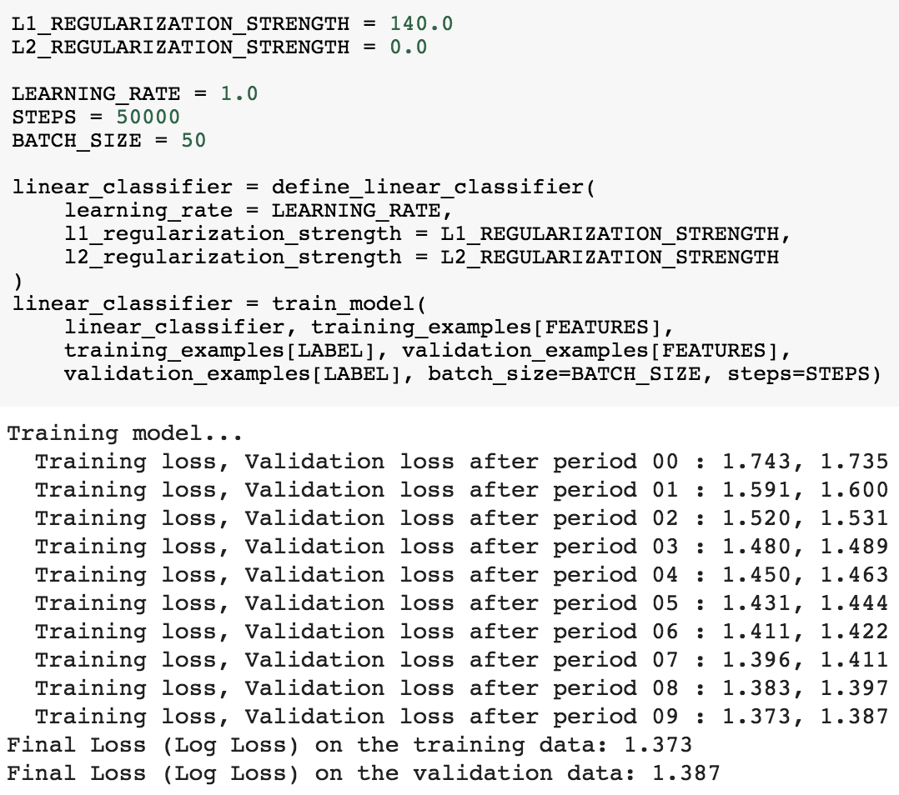
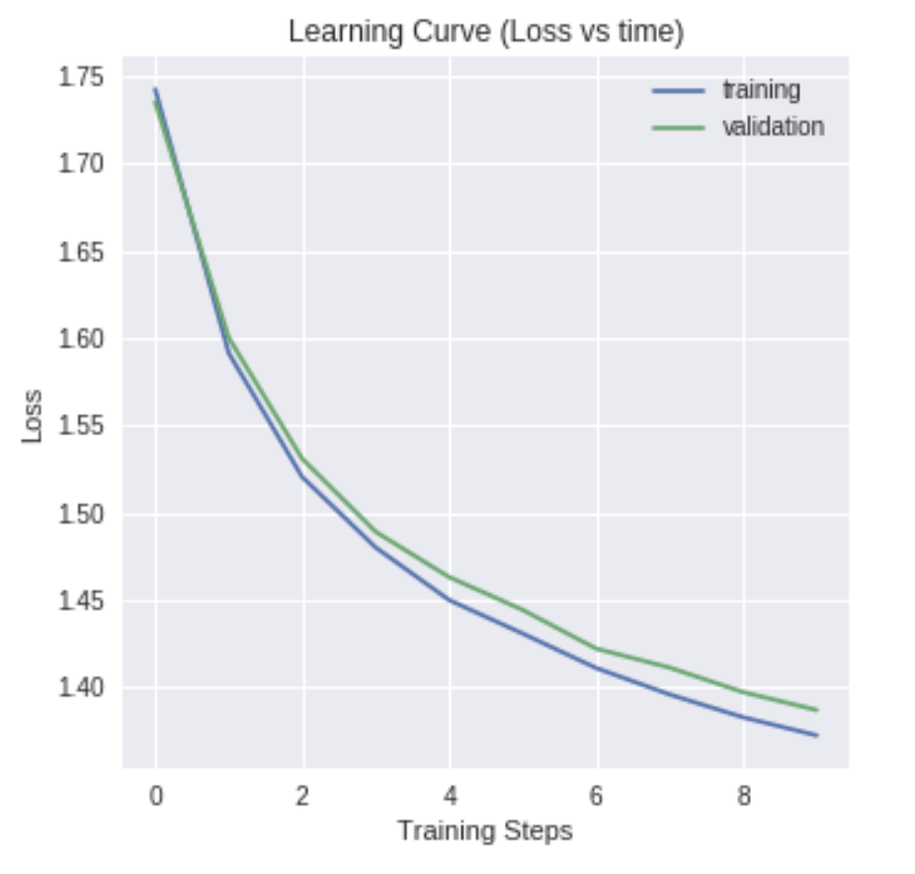
With Modifications
52% Accuracy

Slide 18
Deep Neural Network

Slide 19
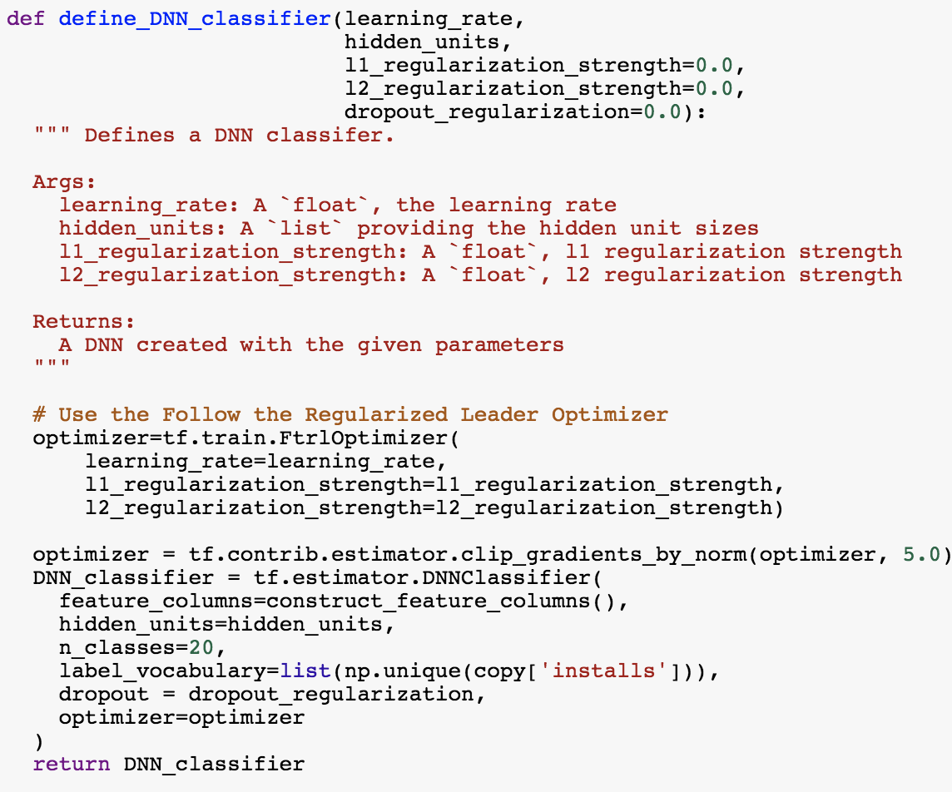
Setting up the DNN
Most of the preliminary work is the same
Categorical features turned to embeddings
Almost the same code

Slide 20
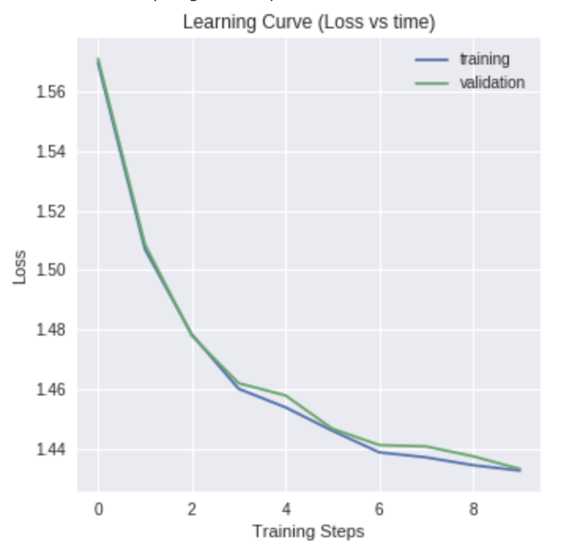
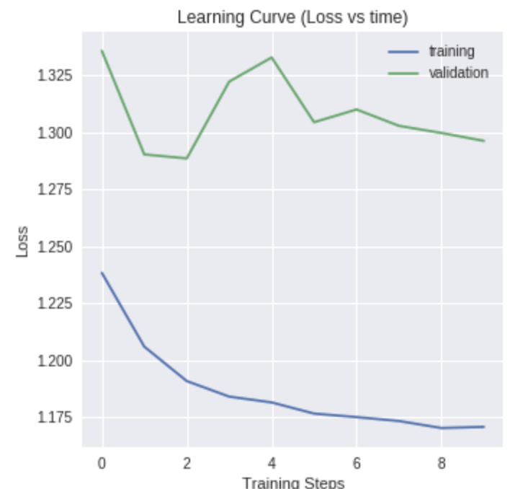
Early Models

Slide 21
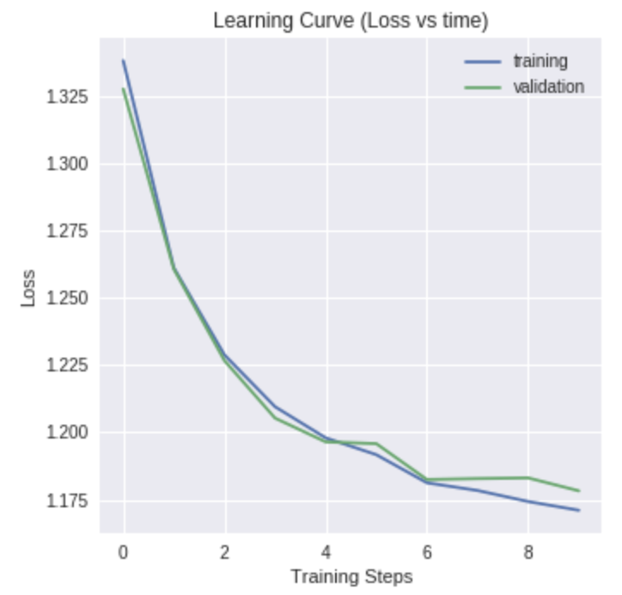
Most Stable Model
1 Layer
14 Neurons
0.1 Learning Rate
50000 Steps
0.05 Dropout regularization

Slide 22
Best for this problem?
I prefered Linear Model for its simplicity, and numerical representation
Gave predictions with an error range of a factor of 10
Logistic and DNN was too long
Both give decent predictions

